Slide 1



April – June 2025

Slide 2

1. | Infographic - VRP Reach 2025/2026
2. | Education
3. | My Tomorrow
4. | Change Makers
5. | Data & Evaluation
6. | Health
7. | Sport
8. | Criminal Justice and Exploitation
9. | Faith and Community Engagement
10. | Working with West Midlands Police
11. | Local Area Update
12. | Forward Look

Slide 3
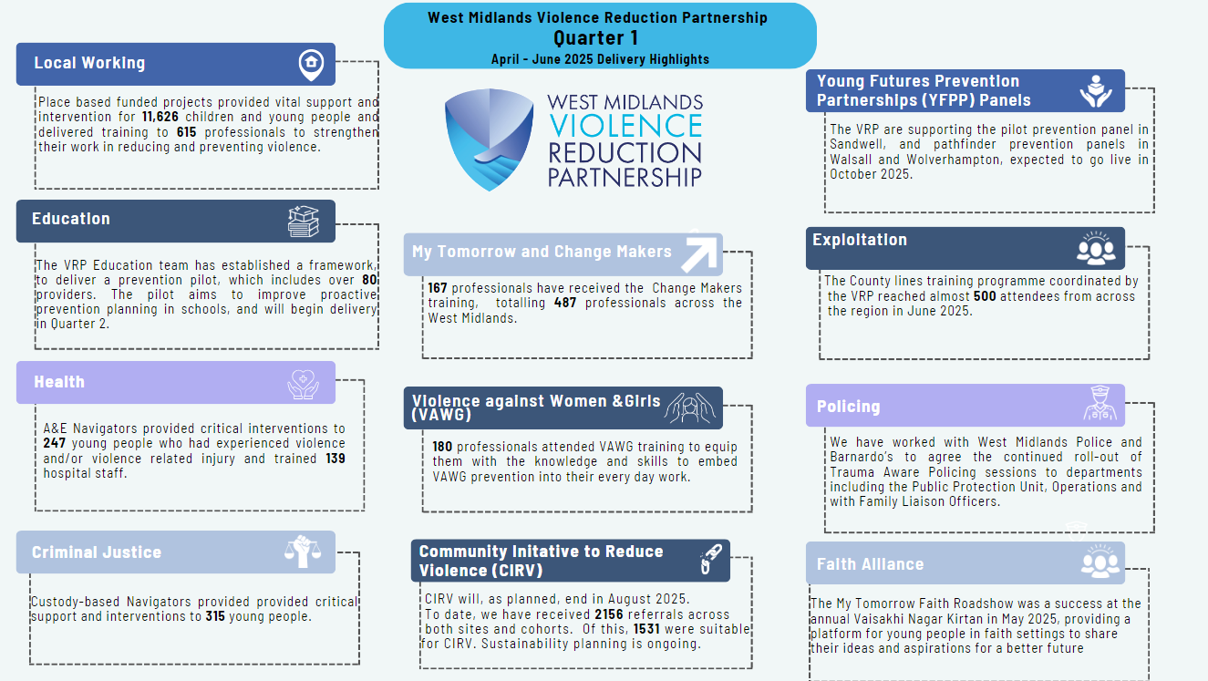

Slide 4
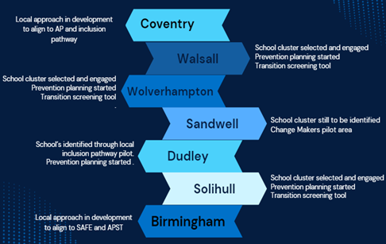


Education
Regional webinars
Primary Prevention Offer
Prevention Pilot
475 professionals have engaged with the VRP webinar series
The VRP primary prevention offer reached over 817 children.
Notes:
The VRP Education Team are working across the region to provide training, support and advice in education settings.
Prevention Pilot:
The Education Team have established the Education Prevention Pilot and are starting to develop a provider framework which will support delivery of the pilot.
Expressions of interest for the framework has resulted in over 80 applications.
The ambition is to have a framework that commissioners across the region are confident to use which in turn, will ensure high quality, evidence-based provision are available for our children.
Regional Webinars:
475 professionals have engaged with the VRP webinar series which focuses on Introduction to childhood adversity and Trauma Informed Practice; Trauma Informed Practice in Early Years; Ending Male Violence Against Women and Girls; Introduction to Exploitation; Serious Violence Duty; Public Health Approach; Trauma Informed Practice; and Early Years. Programmes and Interventions were delivered either through train the trainer programmes or directly delivered to with young people.
Primary Prevention Offer:
During quarter 1, our primary prevention offer reached over 817 children.

Slide 5
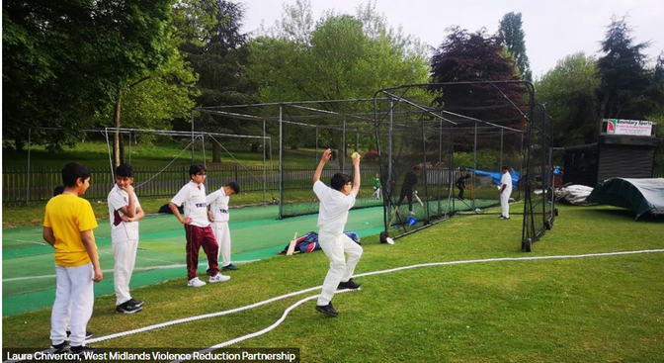
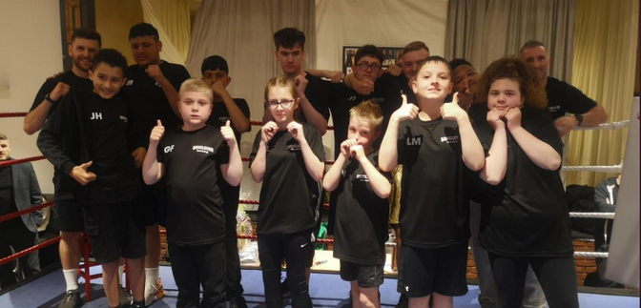
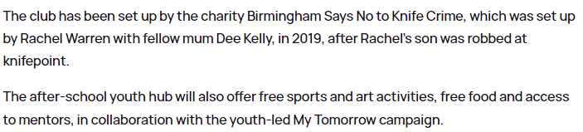
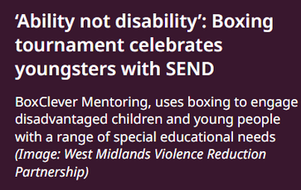

My Tomorrow
Notes:
My Tomorrow
My Tomorrow, the region’s counter narrative campaign, continues to gain significant traction across the region resulting in positive media coverage.
Young leaders have been taking part in workshops to develop Change Maker sessions that they will be delivering directly to young people in faith spaces, youth and community settings.
My Tomorrow has had excellent media coverage, which has enhanced the number of people engaging with the campaign.
Some of the news stories are highlighted on the screen, which demonstrates the impact of the campaign across the region, as demonstrated across Birmingham and Sandwell above.
If you would like to read more about My Tomorrow in the media, please email vrp@westmidlands.police.uk.

Slide 6
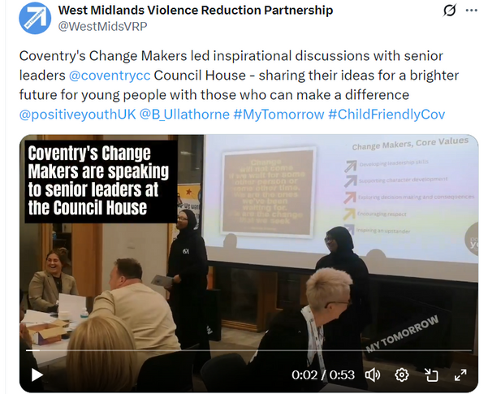
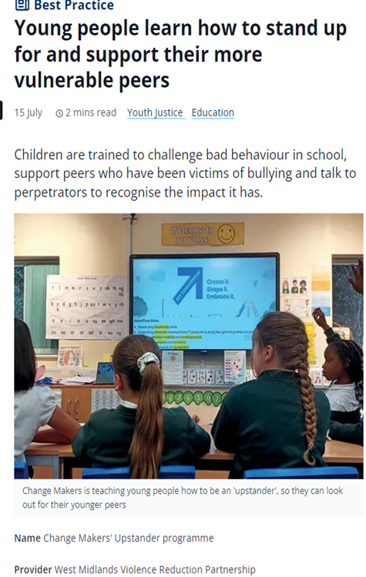
Change Makers
39 sessions delivered in schools, with over 320 professionals being trained to deliver the programme.
Notes:
Change Makers is our flagship upstander programme, alongside the My Tomorrow campaign – continues to pick up pace.
Led by the VRP Education Team, using a ‘train the trainer model’, Change Makers offers an initial 6 sessions which can be delivered in schools, youth and community settings, and explores the upstander approach, which seeks to empower and equip young people with skills and confidence to use their voice for positive change and stand up to violence.
Impact:
During quarter 1, 39 sessions have been delivered in schools, with over 320 professionals being trained to deliver the programme.
Change Makers is being piloted in Sandwell primary schools with Phoenix Psychology, where we will be capturing children’s pre and post-feedback.
Additional Change Maker sessions are currently in development and will be progressed with Young Leaders over the Autumn term ready for use in January 2026.
In Coventry, a Crown Court Judge met with a group of children and young people (for the second time) at Coventry Academy where they provided their views of how young people can be better supported in the criminal justice system. The Judge provided excellent feedback from these sessions and has been able to take this information back to his organisation. Coventry Academy are working with us to coordinate a series of My Tomorrow Conversations, that places senior leaders from the system in front of young people so their voices can be heard.
The media coverage shown on the screen are just a few examples of how children, young people, partners, professionals and communities have got behind and embraced My Tomorrow, using the concept as a platform to give children and young people access to opportunities to make their voices heard.
This is at the heart of My Tomorrow, and we are so grateful to the commitment that has been shown to grow the movement, building a counter-narrative around the vibrancy, positivity, creativity and potential of our children and young people.

Slide 7




Data & Evaluation
Evaluation
Consultant
Reviewing 25/26
priorities
Finalising Reports and Evaluation
WMOPCC / VRP Collaboration
Notes:
Evaluation Consultant:
We have commissioned an independent consultant to lead on our evaluation work – Tori Olphin. Tori brings a wealth of expertise in data science, analytics, and evaluation. Her role will be pivotal in designing, monitoring, and evaluating commissioned services, as well as in building capacity across the team and wider partnership through knowledge sharing and support.
Reviewing 25/26 priorities:
The Data and Evaluation team have experienced some staffing changes during quarter 1 which has provided an opportunity to review our focus and set clear priorities. Which include:
Creating a Strategic Performance Framework to support us in understanding impact of our regional strategy
Refreshing our Strategic Needs Assessment and working with local community safety partnerships and PILT to align our products and timescales
Understanding opportunities to align our work more closely with the Police intelligence/data functions
Finalising the regional Data Sharing Protocol, to support delivery of the Serious Violence Duty
Monitoring our Interventions
Finalising the VRP Evaluation Plan
Supporting regional and local requests for data and information
Supporting Prevention Panels
Working with the Home Office on their new initiative around hyper local targeting to reduce knife crime

Slide 8



Health
Interventions
Training
Resources
A&E Navigators (St Giles and Redthread) provided critical interventions to 247 young people
139 hospital staff trained to provide violence reduction interventions.
Consistent sign-up rate across the VRP Health and VAWG-related webinars. 180 professionals ‘attended’ EMVAWG (Q1)
80 Healthcare professionals attended TIP in healthcare (Q1).
Developed robust guidance relating to Ending Male Violence Against Women and Girls (EMVAWG), for inclusion in the VRP Education Toolkit.
Notes:
Interventions:
A&E Navigators provided critical interventions to 247 young people who had experienced violence and/or violence related injuries and trained 139 hospital staff to provide violence reduction interventions.
Lived experience navigators are embedded across the Black Country Emergency Departments, ensuring coverage across the five sites via a rota system. Delivery also takes place in Queen Elizabeth, Heartlands Hospital, University Hospital Coventry and Warwickshire.
Feedback from the newest site in Walsall has been positive, with hospital colleagues remaining enthusiastic about the service.
Plans are in place for the Redthread team to deliver violence against women and girls (VAWG) training.
Training:
(Health) The VRP Health Delivery Manager has delivered the “Introduction to trauma informed practice in healthcare settings”, which introduces the basics of understanding adversity & trauma, its impacts on health, and begins to explore working in a more trauma informed way in healthcare settings. The webinar has reached over 80 healthcare professionals throughout quarter 1.
(VAWG) The Introduction to EMVAWG webinar continues to have a good sign-up rate, with over 180 professionals ‘attending’ this training during quarter 1.
Resources:
(VAWG) The VRP VAWG Navigator has developed robust guidance relating to Ending Male Violence Against Women and Girls (EMVAWG), for inclusion in the VRP Education Toolkit.
(Health) Senior Clinical Psychologist’s from Phoenix Psychology have continued to work within the VRP developing toolkits, resources and support for local violence reduction boards to streamline pathways and connect young people effectively to mental health support and intervention. Looking ahead throughout 2025/2026, Phoenix Psychology will support clinical case formulations and reflective supervision to key violence prevention teams across the region, including specialist dedicated violence and exploitation hubs.
Other highlights:
The VRP Clinical lead has supported health colleagues in compliance with the Serious Violence Duty. The VRP has now taken on chairing the regional SVD strategic & operational groups for health partners and have secured senior nominations from the Chief Executive of each hospital Trust.

Slide 9



Sport
The VRP have been working with StreetGames over Quarter 1 to understand how we can continue to embed the regional sports strategy across the West Midlands. Over the next financial year, this will include:
Reviewing the Sports Partnership network
Presenting the Regional Sports Audit Map
Supporting workforce development opportunities
Notes:
Sport:
The VRP have been working with StreetGames over Quarter 1 to understand how we can continue to embed the regional sports strategy across the West Midlands.
During quarter 2, the Sports Partnership networks will be reviewed and the Regional Sports Audit map will be presented to partners.
The VRP will support StreetGames’ direct engagement, capacity building and delivery across the region.
The VRP will continue to support professionals across the Sports sector with workforce development opportunities.

Slide 10


Criminal Justice and Exploitation
Commissioned Interventions
CIRV
CIRV will end in August 2025.
To date, we have received 2156 referrals across both sites and cohorts.
Of this, 1531 were suitable for CIRV.
Criminal justice related/based interventions have reached:
Over 436 children and young people under 24
Over 31 young people over 25
Over 42 professionals, trained on a variety of topics, including (but not limited to) the impacts of parental imprisonment
Notes:
The VRP Criminal Justice work includes a variety of commissioned projects and interventions that are both community and custody based, in spaces when children and young people can be at their most vulnerable.
These programmes provide extensive support to children and young people on the cusp of or engaged with the criminal justice system.
CIRV:
Delivery of the Youth Endowment Funded programme, Community Initiative to Reduce Violence (CIRV) will, as planned, end in August 2025.
Since its inception, CIRV has made a real difference to the lives of many young people, providing vital intervention, guidance, and opportunities to help some of our most vulnerable young people towards a more positive future.
This success has been a testament to the dedication and collaboration of all our partners, and we are incredibly proud of what we’ve achieved together.
As we approach the conclusion of the project, we are working with partners to ensure a smooth transition and continuity of support for those currently engaged. Alongside this, we will look to embed and replicate key elements of CIRV within existing services to maintain the progress made. Key highlights from the programme include:
102 people have successfully left the programme with their needs met, which is a larger increase than previous quarters. Both CIRV teams are working with local partners to ensure onward referrals are made, and exit plans are put in place both on a system and an individual level to mitigate the impacts of the project ending.
To date, we have received 2156 referrals across both sites. Of this, 1531 were at some point suitable for CIRV. 601 were in control groups, and 872 were in treatment or case worked cohorts.
The CIRV Conference was well attended and provided an opportunity for partners to take learning from the CIRV process. This includes the role of each partner in supporting young people, sequencing of support, and the voice of young people’s experience of working with CIRV.
Commissioned Interventions:
In addition to the above, the VRP Criminal Justice work includes a variety of commissioned projects and interventions that are both community and custody based, in spaces when children and young people can be at their most vulnerable.
The interventions target young people across the region who may be on the periphery or entrenched in exploitation and/or the criminal justice system.
So far in this financial year, criminal justice related/based interventions have reached:
Over 436 children and young people under 24
Over 31 young people over 25
Over 42 professionals, trained on a variety of topics, including (but not limited to) the impacts of parental imprisonment

Slide 11
Exploitation
Screening Tool
County Lines Training
The exploitation screening tool language pilot is ongoing.
In April 2025, partners suggested piloting a change in risk categorisation language on the screening tools for 6 months until October 2025, the proposed language is:
Entrenched (High)
Targeted (Medium)
Vulnerable (Low)
The County lines training programme coordinated by the VRP reached almost 500 attendees from across the region in June 2025.
Notes:
County Lines Training
The VRP supported the National County Lines Operation which saw the force shut down 241 County Lines. 113 arrests were made across the region, a 31% increase compared to last year. 42 adults and 71 children were also safeguarded from exploitation with officers putting in extra referrals to support services. We also visited 17 suspected ‘cuckooed’ / home invaded properties.
The County lines training programme coordinated by the VRP reached almost 500 attendees from across the region in June 2025.
Screening Tool:
The Exploitation screening tool language pilot is ongoing.
Feedback on the pilot will be held in October with facilitation from Phoenix Psychology.
In April 2025, partners suggested piloting a change in risk categorisation language on the screening tools for 6 months until October 2025, the proposed language is:
Entrenched (High)
Targeted (Medium)
Vulnerable (Low)

Slide 12


Faith and Community Engagement
My Tomorrow
Faith Roadshow Launch
Training
Engagement
The VRP launched Violence Prevention training sessions for Faith communities to provide the Faith community with a basic overview of the public health approach to violence.
The VRP have mapped faith spaces across Walsall, and Young Leaders have connected with places of worship across the local area.
The My Tomorrow Faith Roadshow launch was a success at the annual Vaisakhi Nagar Kirtan in May 2025.
Notes:
The VRP and the Faith Alliance are working closely with partners to implement preventative strategies, including enhanced youth engagement. The VRP Faith Alliance has played a key role in responding to incidents with a coordinated, community-led approach
Training
We have launched a Violence Prevention Webinar for Faith communities. This introductory training module was developed to provide the Faith community with a basic overview of the public health approach to violence.
Engagement
Walsall faith spaces are being mapped and early discussions have taken place re. the Faith Alliance. These places of worship have been connected with the young leaders who will deliver a session during the Summer.
The My Tomorrow campaign, Change Makers young leaders programme, Faith Alliance and new Community Engagement strategy all increase the involvement of communities with the VRP, placing them centrally and in leadership roles in decision making and co-production. The Change Makers programme is growing across the Faith sector and there will be a faith specific young leaders’ group, that will seek to embed youth leadership on Change Makers in faith settings across the region.
My Tomorrow - Faith Roadshow Launch
The My Tomorrow Faith Roadshow was a success at the annual Vaisakhi Nagar Kirtan in May 2025. This initiative delivers leadership training to young people in places of worship, fostering unity and interfaith understanding. It provides platforms for young people to share their ideas and aspirations for a better future.

Slide 13


Working with West Midlands Police
Reductions
Partnership
Trauma Informed
Agreed priorities for continued roll-out of TI training to WMP departments.
Will focus on train-the-trainer model for sustainability purposes.
Reviewing Stop and Search policies, and delivering training to Stop and Search scrutiny panel members.
Working with Custody and IT to enhance the software available on tablets for use by children in custody.
End of quarter one data has shown a 14.23% reduction in serious youth violence (compared with the same time last year).
Worked closely with WMP on knife crime specific data to ascertain new sites for knife bins.
Collaborated in preparation for summer mitigation activity.
Worked together in response to incidents of serious youth violence.
Notes:
The Violence Reduction Partnership and West Midlands Police continue to work closely together to strengthen our individual and collective responses to preventing violence. Police serious youth violence data is regularly shared within the wider strategic partnership to ensure a collective understanding of patterns and trends and to support a multi-agency response. The recently refreshed Targeted Guardian Patrol areas have been shared in partnership spaces including Summer mitigation planning meetings.
Reductions
Across the region we continue to see reductions in incidents of serious youth violence, including a 14% reduction at the end of quarter one, compared with the same time last year. All seven Local Authority areas achieved a reduction, specifically where a knife has been used.
Partnership
The VRP are now leading on the weapon surrender bin contract on behalf of the OPCC. Part of this work has included close working with WMP on knife crime specific data to ascertain new sites for knife bins.
We Collaborated in preparation for summer mitigation activity- The Violence Reduction Partnership and West Midlands Police continue to work closely together to strengthen our individual and collective responses to preventing violence.
Police serious youth violence data is regularly shared within the wider strategic partnership to ensure a collective understanding of patterns and trends and to support a multi-agency response.
The recently refreshed Targeted Guardian Patrol areas have been shared in partnership spaces including Summer mitigation planning meetings.
The VRP have a key role in police consequence management meetings which take place in the immediate aftermath of incidents of serious violence.
We ensure that the wider impact of the incident is responded to in an attempt to prevent the onward transmission of violence and response to the trauma in the community.
Examples of incidents where support has been offered include a violent disorder involving several young people in a public place, a firearm discharge and a serious assault involving the use of a knife. Resources have been invested to prevent further victimisation and support those in need. As part of these packages of support, detached youth workers have been funded and deployed into relevant areas and schools have been engaged with and offered long term violence prevention planning support.
Trauma Informed
Work across the police continues on their journey to become a trauma informed organisation.
During quarter one priorities have been agreed which include the continued roll-out of training to departments including the Public Protection Unit, Operations and Family Liaison Officers.
To ensure this work is sustainable, Barnardo’s will also be delivering train-the-trainer modules with a focus on staff within centralised and local training departments and Force Contact.
An extensive programme of work is underway with the Operations Department regarding the execution of warrants.
This has included focus groups, working with partners such as Children Heard and Seen, the development of a practical resource for families (including young children) who have been impacted by the execution of a warrant and training for officers involved in this process. Software available on tables used by children in custody is being enhanced.
This includes the development of videos explaining the custody process, videos from partner agencies and enhancing the availability of features which will ground and educate children.

Slide 14

Local Area Update - Birmingham
Rhymes over Crimes Exploitation Awareness assemblies reached over 1000 young people in Birmingham
Birmingham Says No continued after-school youth club in Handsworth park, reaching 80 new young people.
Early intervention programme “Circle of Friends” received 32 new referrals.
Phoenix Psychology co-located a Clinical Psychologist in the Birmingham Children’s Trust EMPOWERU Serious Youth Violence Hub
Notes:
Birmingham
Rhymes Over Crimes delivered impactful assemblies raising awareness of the risks of knife crime and exploitation in schools located in areas impacted by high levels of violence. Over 1,000 students in North Birmingham participated.
‘Birmingham Says No’ continued their weekly after-school youth hub in Handsworth Park, and reached over 80 new young people. The Youth Hub received significant media attention, with coverage from Midlands Today, Hits Radio, Global Radio, and Birmingham Live.
Birmingham City Football Club (BCFC) Kicks Programme delivered football activities and mentoring to engage young people at risk of engaging in anti-social behaviour and youth violence. The programme now operates in 9 schools across East Birmingham, reaching approximately 200 students.
Circle of Friends, delivered by The Children’s Society, is an early intervention programme working with 10–14-year-olds. It aims to build skills in conflict resolution, peer pressure management, and informed decision-making. Delivered in small groups by a trusted adult, the programme fosters a shared identity and encourages pro-social behaviour. Since April 2025, 8 fixed groups have been established, with 11 new groups recently added—representing 32 new referrals.
Phoenix Psychology have co-located a Clinical Psychologist in the Birmingham Children’s Trust EMPOWERU Serious Youth Violence Hub who provides:
o Service Development and Evaluation
o Clinical Supervision
o Complex Case Formulations and Intervention Planning
o Risk Assessments and Management Planning
o Training
o Specialist Neurodiversity Assessments

Slide 15
Local Area Update - Coventry
VRP funded interventions reached 3600 children and young people in Coventry.
Coordinated the Coventry Partnership Tactical Board with WMP, to support violence reduction.
VRP, Police and the Youth Justice Service coordinated a Child Friendly Custody’ piece of work, which engaged two young people identified by YJS
Notes:
Coventry
VRP funded interventions reached 3600 children and young people in Coventry.
Worked with local partners planning for the Summer - an outreach model will increase the number of youth workers across the City. The approach this year has been improved, using the learning from previous years. This year we have been able to up the number of youth workers each day and expand from just the city centre to areas across Coventry. We have also changed the methodology slightly in light of lessons learned during pervious holiday period outreach. We also have a more detailed briefing document with purpose, objective, locations, plus key services across the city to support and help young people – QR codes for things like mental health services, drugs and alcohol support, sexual health services, food banks, exploitation advice
Supported West Midlands Police to establish and coordinate the Coventry Partnership Tactical Board to support violence reduction which sits under Coventry’s Strategic Violence Board.
The VRP Navigator is co-lead for the ‘Be Safe’ strand of Child Friendly Coventry and has led on co-ordinating a partnership event in June to showcase the work taking place across Coventry.
Effectively managed the Step Together programme across the City Centre and Hillfields routes. Regular meetings have taken place with relevant schools, Sky Blues in the Community (the provider), Coventry City Council and the Police to ensure the programme continues to meet local needs in terms of keeping children safe during their route home from school. Sustainability conversations will continue in quarter 2.
VRP, Police and the Youth Justice Service coordinated a Child Friendly Custody’ piece of work. Working with 2 young people identified by the Youth Justice Service, they visited Willenhall Police Station to identify how the custody process and environment could be better improved from a trauma informed and child appropriate perspective.
VRP Education Pilot – Helen Kirkman has been working with Lea-Ann, Faye Parklen and Ed Baynes-Clarke on working through what the education pilot will look like in Coventry. Coventy to submit a proposal, which involves them using the additional money to support each school have one further place on Tier 1 within the CAP framework, which is the Universal Support Pathway and includes work-based learning, curriculum and employability courses. This proposal is currently being considered
Tizz Time – Judith Staff does her delivery in two terms, the Autumn and Spring term so this gets claimed for in Q2, 3 and 4.
SOS+ - this would normally be year round, but as we lost the main mentor Liam to Coventry Youth Justice Service, CCC have needed to renegotiate the terms with St Giles and also St Giles have needed to advertise for a new mentor. The money will still be spent, but again in Q2, 3 and 4.

Slide 16
Local Area Update - Dudley
22 young people at high risk of exploitation benefited from intensive mentoring interventions delivered by CSKN and Cranstoun –
Here 4 YOUth.
During County Lines Intensification week, Phase Trust delivered training to 86 professionals on working with women and girls who have been criminally exploited.
The local stakeholder network continues to be well attended, and a space where best practice and resources can be shared.
Notes:
Dudley
The local stakeholder network continues to be well attended, and a space where best practice and resources can be shared.
CSKN and Cranstoun Here 4 YOUth continue to deliver mentoring interventions, including lived experience focused interventions to those at high risk of violence/exploitation. In quarter 1, 22 young people benefited from intensive interventions.
Phase Trust, continue to deliver harmful sexual behaviour programmes and mentoring. During County Lines Intensification week they also delivered training on working with women and girls who have been criminally exploited.
The local partnership has agreed to re-establish the local Violence Prevention Group with a relaunch workshop planned in July to refresh their violence SNA and violence prevention plan.

Slide 17
Local Area Update - Sandwell
VRP funded interventions across Sandwell reached 1156 young people.
The Change Makers
Young Ambassadors have contributed to events and attended youth service activities to increase engagement with the My Tomorrow campaign.
The VRP have coordinated the implementation of the Prevention Panel in Sandwell.
Notes:
Sandwell
Commissioned Interventions: VRP funded services have reached 1156 children and young people. These services include sport interventions, detached youth work, mentoring, and diversionary activities.
Prevention Panels: Sandwell will pilot a Prevention Panel from October 2025 funded by the Home Office as part of the national Young Futures programme, this will provide opportunities to provide more young people with early intervention across the borough. Sandwell submitted their delivery plan to the Home Office at the end of June, and planned to hold their first steering groups in July.
Change Makers:
The Change Makers Young Ambassadors are contributing to events and attending youth service activities across the Summer to engage more children and young people in the My Tomorrow campaign.
The VRP in partnership with Ambitious Lives, WMP, Horizons, St John’s Ambulance, The Right Path, Youth Justice, Youth services & Sandwell Community School to provide a new diversionary project. The project is currently running for 5 weeks, to conclude when schools break up for Summer.

Slide 18


Local Area Update - Solihull
VRP funded interventions across Solihull reached 2947 young people.
VRP funding has supported the renovation of the Youth Bus. Youth workers provide young people with advice on mental health, job skills and wellbeing.
The intervention delivered by Solihull YJS at Kingshurst Allotments has positively impacted mental health, confidence and creativity of young people on a Referral Order.
Notes:
Solihull
2947 young people aged 24 and under were reached through VRP funded interventions across Solihull.
There has been a significant reduction in SYV in Solihull (approx. 30%).
VRP funding has supported the renovation of the Youth Bus. - Young people in Solihull are set to benefit from a brand-new youth project and a mobile youth bus—bringing support, fun activities and youth workers to their doorstep.The new initiative in Smith’s Wood, North Solihull, will provide a welcoming space for 8 to 17-year-olds to connect, create, and grow. With youth workers on hand during term time, young people can get advice on everything from mental health and job skills to everyday wellbeing.
Sessions delivered by Solihull Youth Justice Service at Kingshurst Allotments have positively impacted young people on a Referral Order. The intervention at the allotments has been beneficial for mental health, confidence and creativity.
Looking ahead, the local partnership will hold a meeting in July to review their violence SNA and violence prevention plan.

Slide 19
Local Area Update - Walsall
The VRP are supporting the pathfinder prevention panels in Walsall, expected to go live in October 2025
The My Tomorrow campaign was promoted at the launch of a new youth hub in the Saddlers Centre, Walsall
The VRP have connected with local partners to increase engagement and collaboration at the VRP Stakeholder Network.
Notes:
Walsall
The VRP are supporting the pathfinder prevention panels in Walsall, expected to go live in October 2025. Walsall will pilot a Prevention Panel from October 2025 within education, as a pathfinder funded by the Home Office as part of the national Youth Futures programme. This will provide more opportunities to intervene early with children and young people and maintain their education. Walsall submitted their delivery plan to the Home Office at the end of June, and will hold their first steering groups over the Summer.
Opportunities continue to be explored to promote My Tomorrow. The new youth hub was launched at the end of June in the Saddlers Centre where My tomorrow was promoted.
Walsall continue to deliver the CARE programme, which engages children and young people and provides key interventions.
The VRP Navigator has been working on connecting with stakeholders and to increase numbers engaged in the under 25 stakeholder network.
We have promoted the VRP universal training offer and have been in discussions with two schools who would like a tailored training plan developed to access training for professionals and interventions for young people.
Other highlights include:
Walsall faith spaces are being mapped and early discussions have taken place re. the Faith Alliance. These places of worship have been connected with the young leaders who will deliver a session during the Summer.

Slide 20
Local Area Update - Wolverhampton
The VRP are supporting the pathfinder prevention panels in Wolverhampton, expected to go live in October 2025
Detached outreach team (EYES) reached over 1,900 young people under 24, and 550 aged 25 and over.
Established a Task and Finish group which will focus on increasing engagement with the My Tomorrow campaign.
Notes:
Wolverhampton
Prevention Panels: Wolverhampton will pilot a Prevention Panel from October 2025 within education, as a pathfinder funded by the Home Office as part of the national Youth Futures programme. This will provide more opportunities to intervene early with children and young people and maintain their education. Wolverhampton submitted their delivery plan to the Home Office at the end of June, and will hold their first steering groups over the Summer.
Outreach: Detached outreach team (EYES) has reached over 1,900 young people under 24, and 550 aged 25 and over.
My Tomorrow: Following the local My Tomorrow launch, a task and finish group has been set up which will look at increasing engagement with the My Tomorrow campaign.
Other highlights:
Wolverhampton hosted a mobile weapon surrender van on 2nd July as part of a national Home Office scheme.
Two new weapon surrender bins were installed, one in Merry Hill and the other in Bilston, funded by the Home Office.
Exploitation awareness training was delivered for staff working in the night time economy as part of Exploitation Awareness Week. As part of this week, social media content and engagement sessions with parents/carers, young people and professionals took place to raise awareness.
To support sustainability, Safer Wolverhampton Partnership have commissioned three voluntary organisations with the HAF Summer provision funding to accompany safer streets (safer towns).

Slide 21
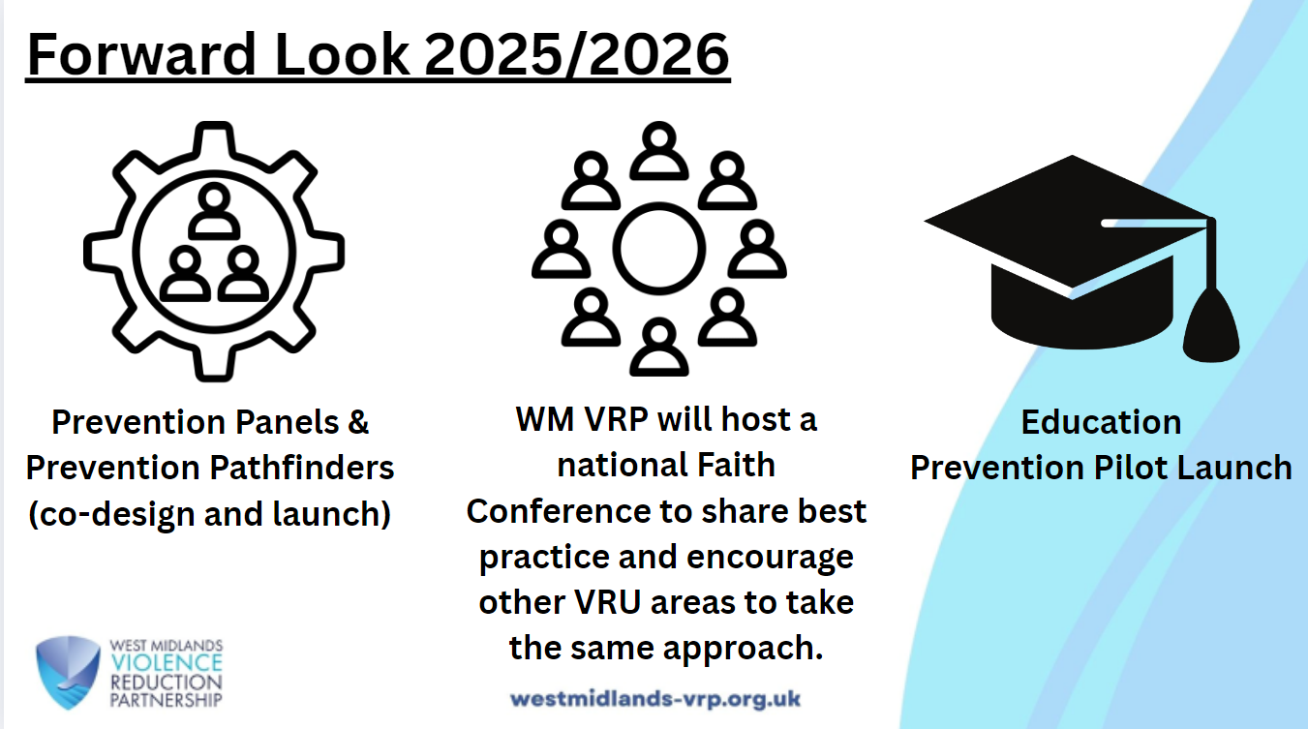
Notes:
Prevention Panels:
The VRP are co-ordinating local implementation of the Home Office pilot prevention panel which is being established in Sandwell and have also been successful in securing funding for two pathfinder prevention panels, which will be located in Walsall and Wolverhampton. We are working closely with the three local authorities to ensure their panels can go live in October.
Faith Conference :
In October, in partnership with five other VRU's, WM VRP will host a national Faith Conference to share best practice and encourage other VRU areas to take the same approach.
Education Prevention Pilot Launch:
The Education Team have established the Education Prevention Pilot and are starting to develop a provider framework which will support delivery of the pilot. Expressions of interest for the framework has resulted in over 80 applications. The ambition is to have a framework that commissioners across the region are confident to use which in turn, will ensure high quality, evidence-based provision are available for our children. The pilot will be launched throughout Q2/Q3 2025/2026.

Slide 22

VRP@westmidlands.police.uk

